Slide 1

ALY6015 -Intermediate Analytics Final Project Presentation CRN: 21495
Project Name: Stroke Prediction
Group Name: Beta
Group Members:
Rambhupal Payyavula (payyavula.r@northeastern.edu)
Cheng Chen (chen.cheng5@northeastern.edu)
Minhang Lin (lin.minh@northeastern.edu)
Sayantan Ganguly (ganguly.sa@northeastern.edu)
Zilin Wang (wang.zilin@northeastern.edu)

Slide 2



Project Overview
According to the data from American Heart Association, in the United States, a person is having heart stroke every 40 seconds, and one person dies from a stroke every 4 minutes.
Studies exploring the clinical features that trigger or increase chance of stroke is the interest of our group.
There are several factors such as level of obesity, diabetes, smoking, etc. that causes the person to suffer from heart stroke .
In this project, We will analyze the heart stroke data to find major factors that causes the heart stroke with the help of statistical techniques.

Slide 3

Dataset
Dataset Name: Shealthcare-dataset-stroke-data.csv
Source: Kaggle (https://www.kaggle.com/fedesoriano/stroke-prediction-dataset)
This dataset contains a total of 5110 records and 12 variables.
id: unique identifier
gender: "Male", "Female" or "Other"
age: age of the patient
hypertension: 0 if the patient doesn't have hypertension, 1 if the patient has hypertension
heart_disease: 0 if the patient doesn't have any heart diseases, 1 if the patient has a heart disease
ever_married: "No" or "Yes"
work_type: "children", "Govt_jov", "Never_worked", "Private" or "Self-employed"
Residence_type: "Rural" or "Urban"
avg_glucose_level: average glucose level in blood
bmi: body mass index
smoking_status: "formerly smoked", "never smoked", "smokes" or "Unknown"*
stroke: 1 if the patient had a stroke or 0 if not

Slide 4
Research Questions
How can we more effectively predict the odds of getting stroke based on the clinical features given?
How can we more effectively reduce the odds of getting stroke?
Does living environment has an impact on the odds of getting stroke?
Do different genders have statistically different odds of getting stroke?
Does the average glucose level have an impact on the odds of getting stroke?

Slide 5
Research Methods
Chi-Square Tests
Since in our dataset, there are several categorical data like work type and resident type, for our final report, we want to perform more chi-square tests to see if there are significant differences between the categories. From these tests, we can find out whether different types of living environments or working environments will affect the chance of stroke.
2. Logistic Regression
Since the interest of our study is stroke, which is a binary variable, for predicting a binary variable, we need to perform a logistic regression. From the logistic regression model, we can see how each variable affect the chance of stroke.
3. LASSO Regression
We also want to perform a LASSO regression. By comparing the LASSO model with the logistic regression model, since LASSO regression may eliminate some variables to simplify the model, we can see which variables may have the higher factor on the chance of stroke.

Slide 6
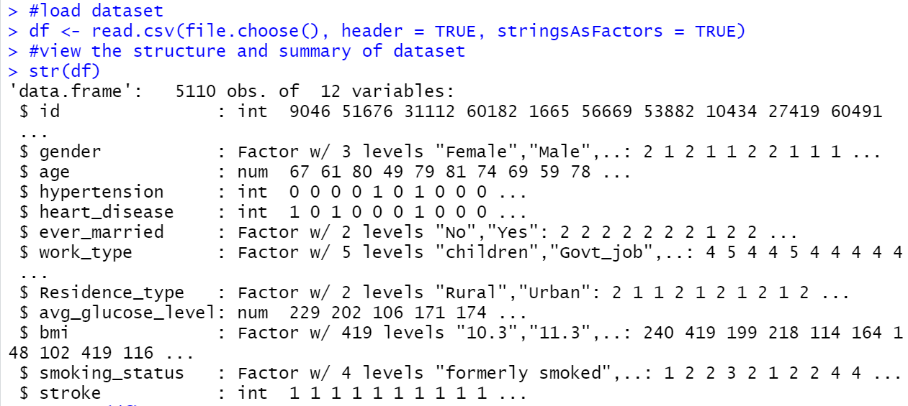
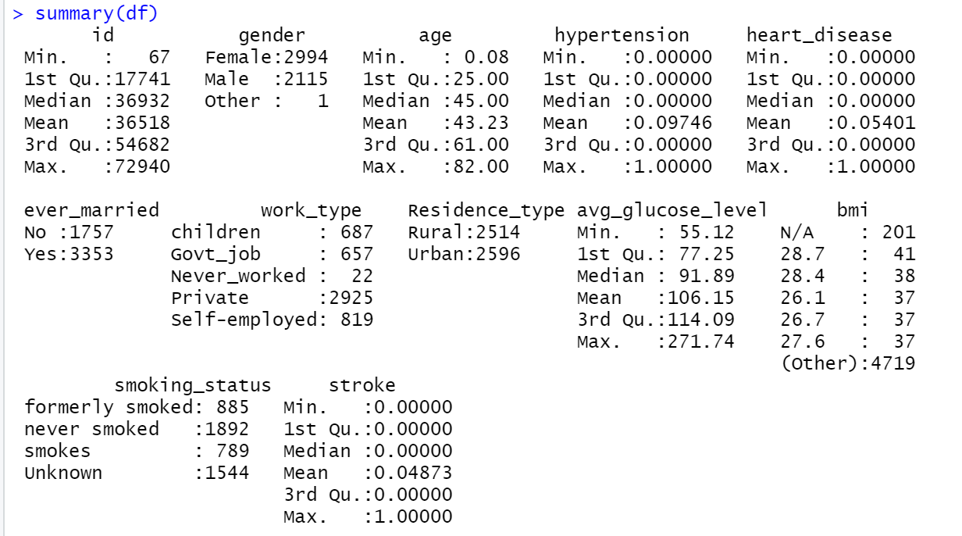
Understanding the data
We first imported the dataset and view the structure of it. We find variables of integer type (e.g. "hypertension", "heart_disease", and "stroke"), factor type (e.g. "gender", "ever_married", "work_type", etc.), and numeric type (e.g. "age", "avg_glucose_level").
We then view the summary of the dataset and find that there was only one "Other" value in the "Gender" variable. Meanwhile, we find that "bmi" variable has 201 N/A values. What’s more, the dataset contains some binary and continuous variables.

Slide 7
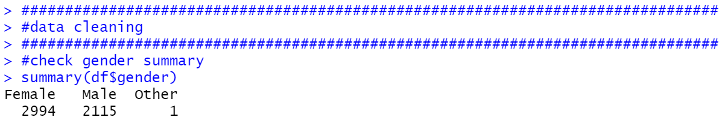
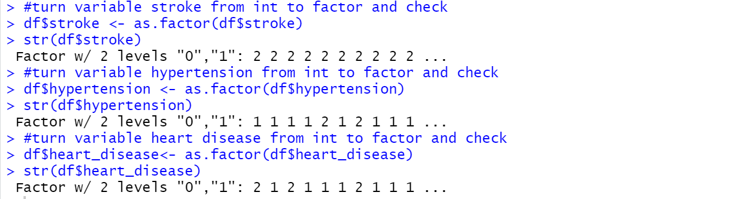
Data Cleaning
From the summary, we find “gender” variable only contains one “Other” value, so we decide to remove it for simplicity. Then, we convert integer variables(“hypertension”,“heart_disease”) to factor for subsequent analysis purpose.
Since “bmi” variable is obviously a continuous value, we convert it from factor to numeric.
In summary, we count there are 201 “N/A” values in “bmi” variables.
We decide to remove “N/A” values as they are less in number.

Slide 8
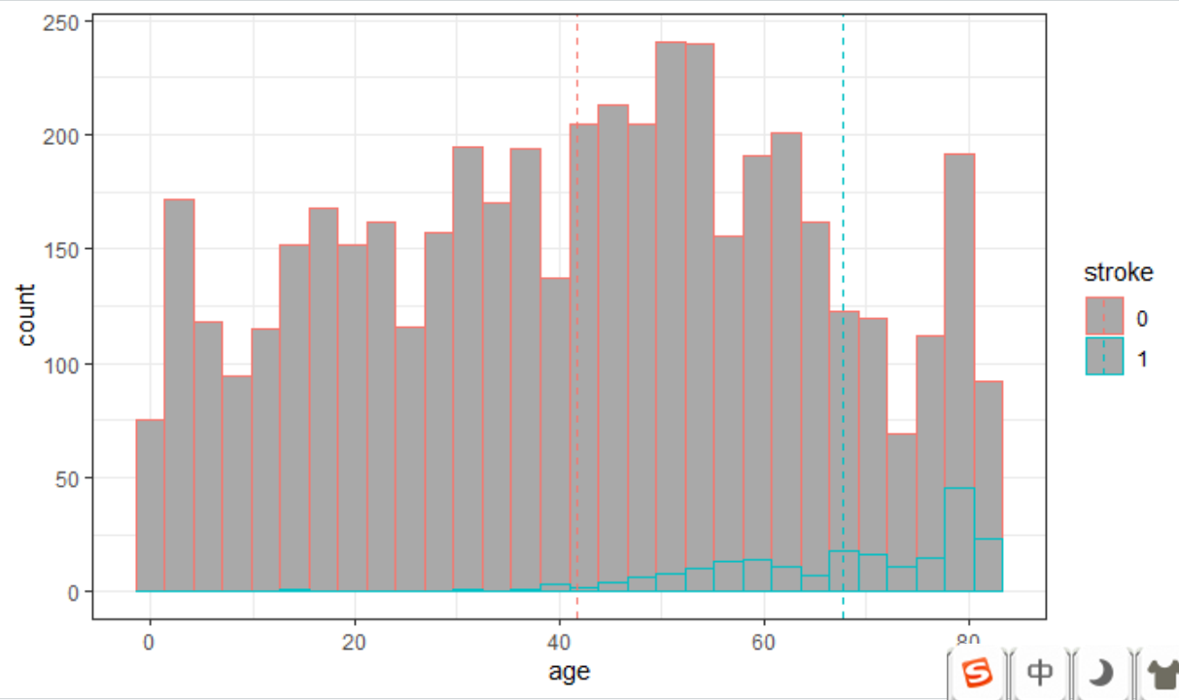
Exploratory Data Analysis
Mean age of the patients’ having stroke is grater than the patients don’t have stroke.

Slide 9
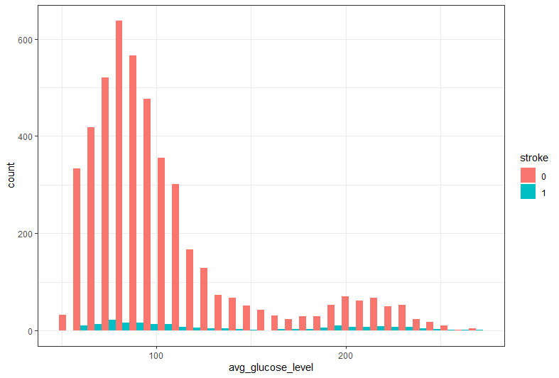
Exploratory Data Analysis
The distribution of average glucose level for the patients with and with out the stroke is almost the same.

Slide 10
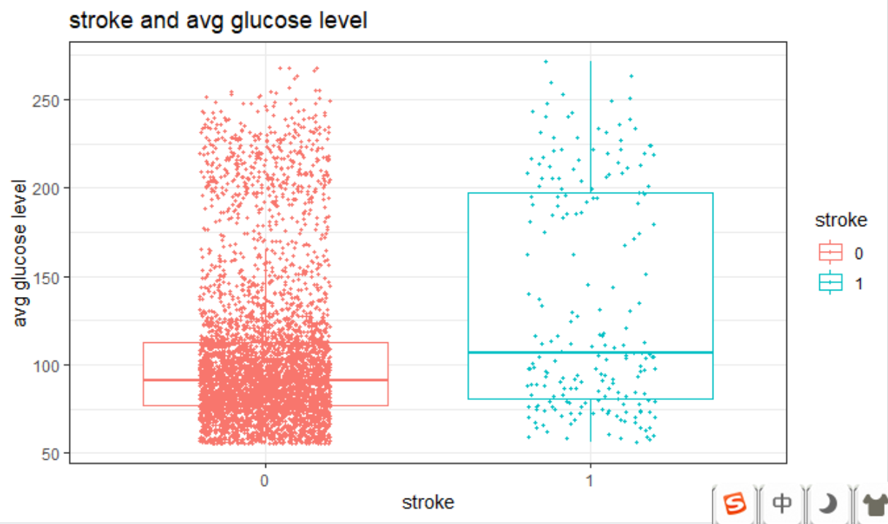
Exploratory Data Analysis
The boxplot above shows the stroke status vs. average glucose level. From the plot, we can see people who don't have Stroke are mostly located inside the box, while most outliers are stretching on the higher end. While people who have Stroke also shows a distribution of right skewed. From this plot, we can't determine the relationship between Stroke and average glucose level yet.
.

Slide 11
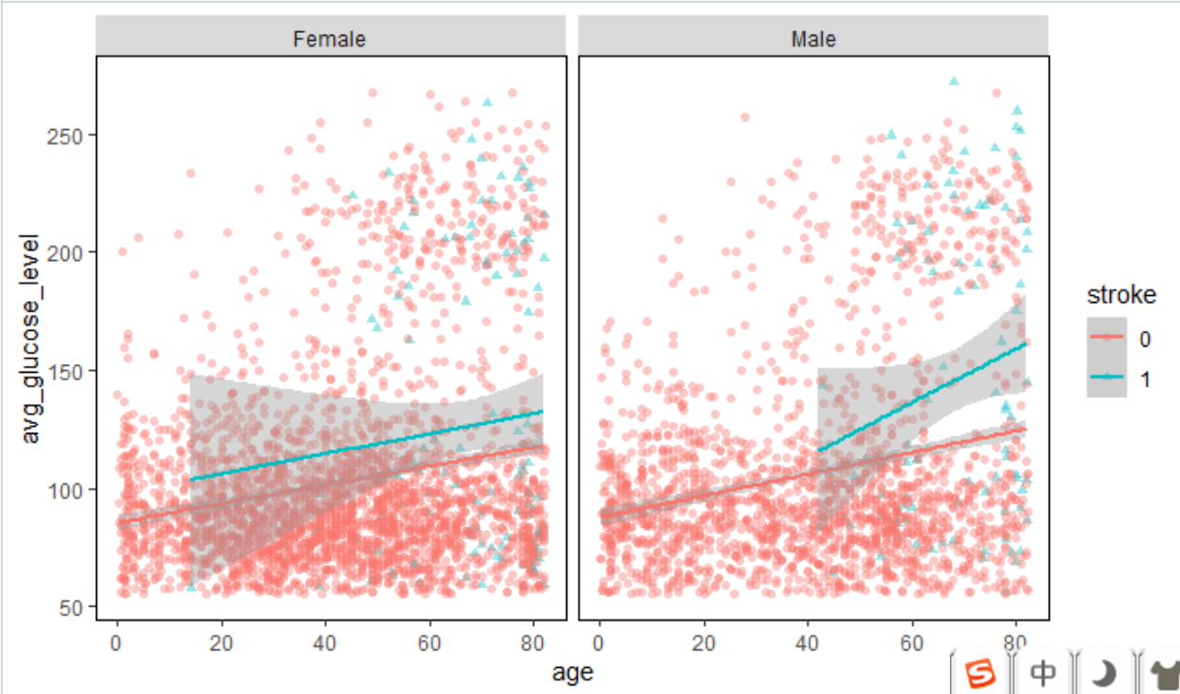
Exploratory Data Analysis
In both the genders, Most of the patients suffered from heart stroke have higher age.

Slide 12
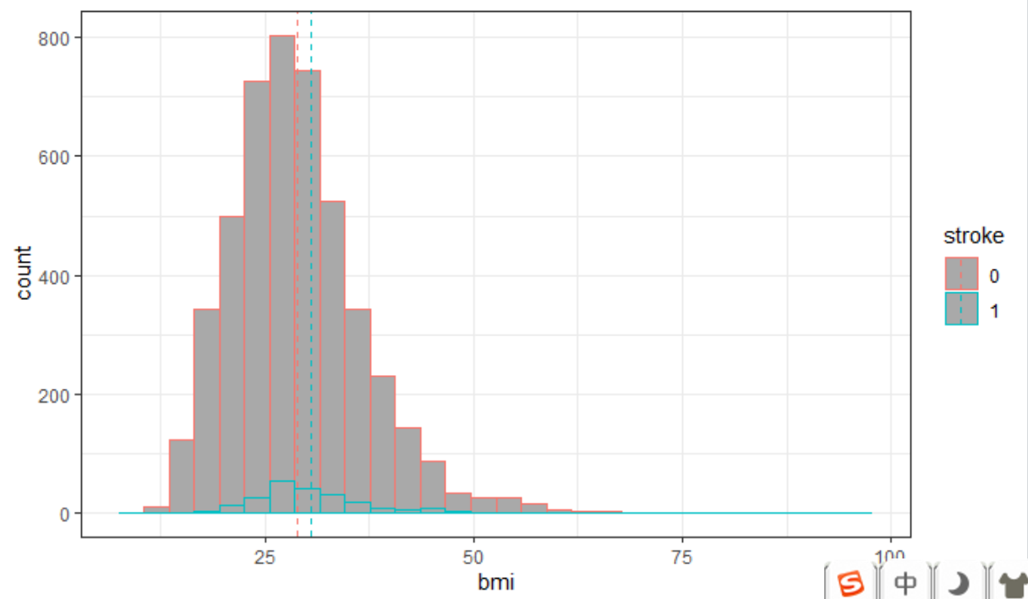
Exploratory Data Analysis
Body Mass Index for the patient's having stroke is slightly greater than the patients not having stroke. So, we guess BMI may not play major role in occurring stroke.

Slide 13
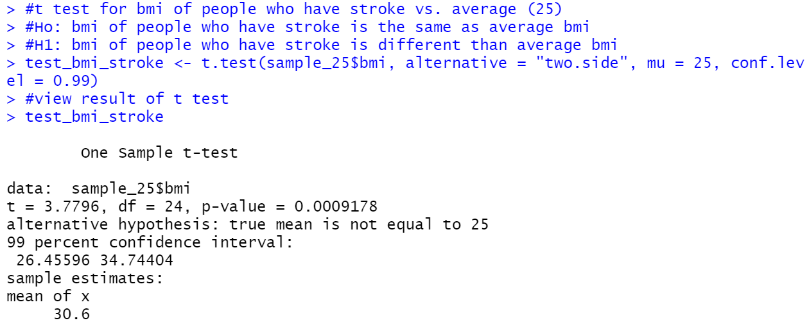
Hypothesis Testing: T test
As p-value of 0.0009178 is less than the significance level of 0.01, There is not enough evidence to accept the null hypothesis. So, BMI of patients who have the stroke is different than average BMI. So, BMI has significant affect on stroke.

Slide 14
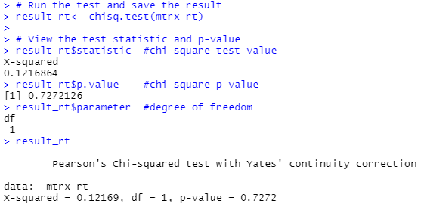
Hypothesis Testing: Chi-Square test
Stating Hypothesis:
H₀: Resident type is independent upon stroke.
H₁: Resident type is dependent upon stroke.
As p-value of 0.7272 is greater than the significance level of 0.05, There is enough evidence to accept the null hypothesis. So, resident type is independent of stroke.

Slide 15
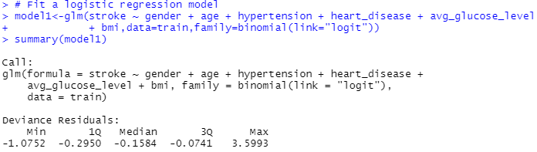
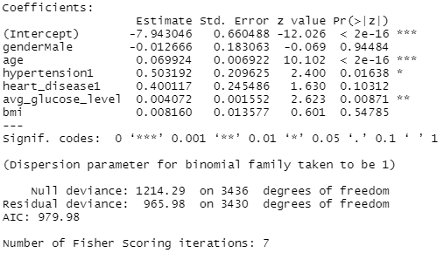
Logistic Regression
P-values for gender, heart disease and BMI are greater than the significance level of 0.05, Which we can conclude that these variables insignificant in the model.

Slide 16
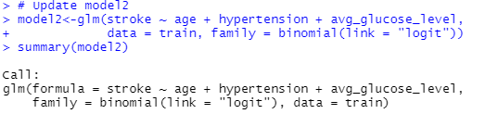
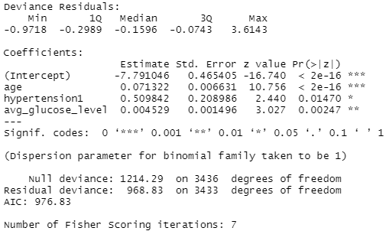
Logistic Regression
From the z-scores of the coefficients, we can see all predictors used are significant in the model. Also, by updating the model, the AIC of the model is improved from 979.98 to 976.83.

Slide 17
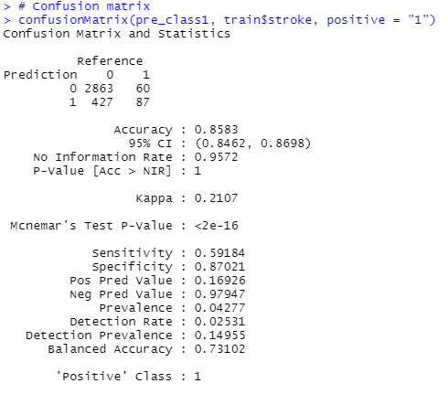
Logistic Regression: Confusion Matrix
We have got the accuracy of 85.83% and the sensitivity is of 59.18%

Slide 18
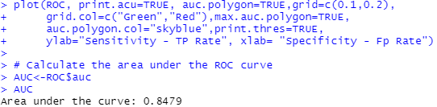
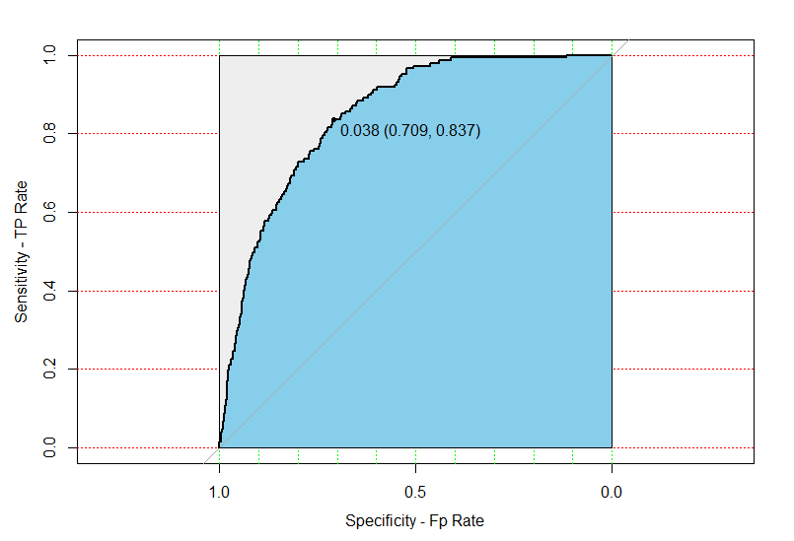
Logistic Regression

Slide 19
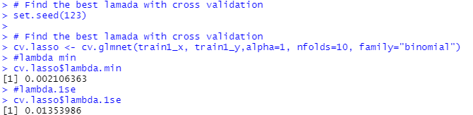
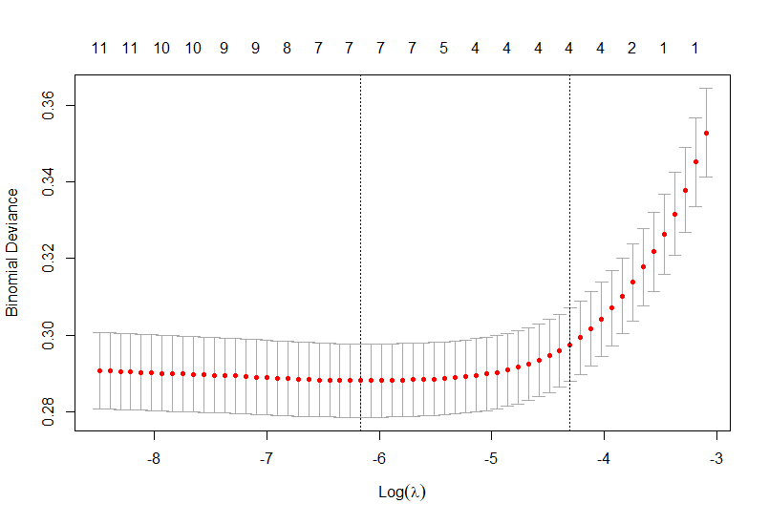
Cross validation
We can see by using lambda.1se instead of lambda.min, the number of predictors used reduces from 7 to 4.

Slide 20
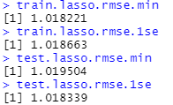
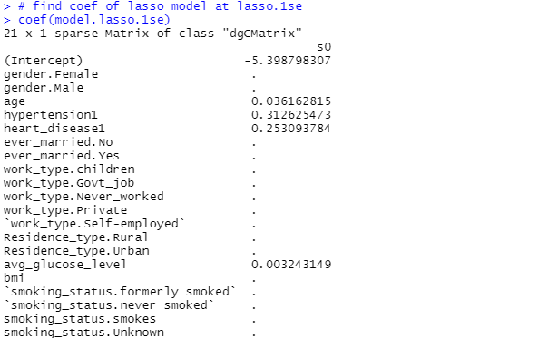
LASSO Regression
From the lasso regression, we decided to include age, hypertension, heart disease and average glucose level in the model.

Slide 21
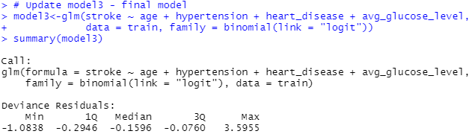
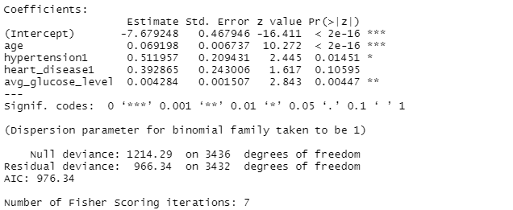
Logistic Regression
Computed AIC value is 976.34 which less than previous model AIC of 976.83.

Slide 22
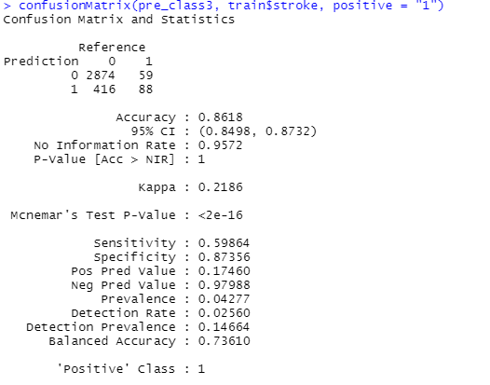
Confusion Matrix
Accuracy has increased from 85% to 86%.and sensitivity has increased from 59.18 to 59.86.

Slide 23
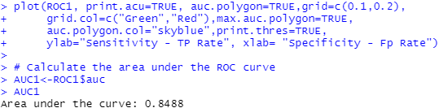
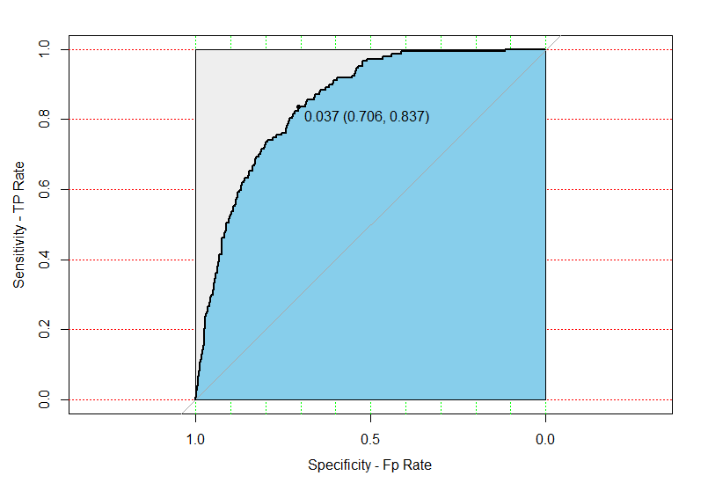
ROC curve
Area under curve has increased from 84.79% to 84.88%

Slide 24
Coefficients and VIF
we can see for each unit increase in age will increase the odds of getting Stroke by 1.07, people who have had hypertension have about 67% more odds of having Stroke than people who have not, people who have heart disease have about 48% more odds of having Stroke than people who have not, and for each unit increase in average glucose level increases the odds of getting Stroke by about 1.

Slide 25
Conclusion
Starting from the exploratory data analysis, we observe that the mean age of patients having a stroke is greater than those not having one. When we segregated the dataset based on sex, we inferred that male are more prone to strokes than females. Next, we observe that the medians of BMI of both the classes of the population are almost similar which means BMI might not play an important role in our analysis. From our testing, we find out that the BMI is in fact a significant feature because its p value comes out to be less than our significance level. Next, we go on to test whether resident type is dependent upon Stroke or not. From the p value statistics, we infer that the Resident level is independent of Stroke. While model building, during the cross validation (using LASSO) we dig out the features which are statistically significant for our analysis. We see that the age, hypertension level, heart disease and average glucose level are significant for our research, so we went ahead for building model with them. After the model is built, we test the model and find out its accuracy to be 86.18%.

Slide 26
References
Centers for Disease Control and Prevention. (2017, September 6). Preventing stroke deaths. Centers for Disease Control and Prevention. Retrieved February 9, 2022, from https://www.cdc.gov/vitalsigns/stroke/
Centers for Disease Control and Prevention. (2021, August 27). About adult BMI. Centers for Disease Control and Prevention. Retrieved February 9, 2022, from https://www.cdc.gov/healthyweight/assessing/bmi/adult_bmi/index.html
Fedesoriano. (2021, January 26). Stroke prediction dataset. Kaggle. Retrieved February 9, 2022, from https://www.kaggle.com/fedesoriano/stroke-prediction-dataset
Virani, S., Salim, Alonso, A., Alvaro, Benjamin, Emelia J., Bittencourt, Marcio S., Callaway, Clifton W., Carson, April P., Chamberlain, Alanna M., Chang, Alexander R., Cheng, Susan. (2020, January 29). Heart disease and stroke statistics-2020 update: A report from the American Heart Association. Circulation. Retrieved February 9, 2022, from
https://www.ahajournals.org/doi/10.1161/CIR.0000000000000757

